Slide 1
Electronics & Electricity
Unit 5 – parallel Circuits
Section 1 – parallel Circuits

Slide 2
Parallel Circuits
Parallel Circuits

Slide 3
The big idea
Ability to draw and label a parallel circuit and indicate the polarity at each resistor
Define the term overloaded circuit
Use the three parallel-resistance formulas
Calculate the equivalent resistance of a parallel circuit
Calculate the total resistance, the total current, and the branch current in a parallel circuit\
Connect batteries in parallel to increase current capacity

Slide 4
Terms
Booster battery
Branch circuit
Equivalent resistance
Kirchoff’s current law
Overload
Parallel circuit
Shunt connection
Total current

Slide 5
Parts of a circuit
An electric circuit is a combination of parts connected to form a complete path through which electrons move
A basic complete circuit has four parts:
The energy source
The conductors
The load
The control device

Slide 6
Parallel Circuit
The loads are connected “across the line”
Meaning that they are connected between two conductors that lead to the energy source
The loads and their connecting wires are called Branch Circuits
All can be called multiple connections and shunt connections
In parallel the loads operate independently
If one branch is disconnected, turned off, or burned open (light bulb) the remaining branches can continue to operate

Slide 7
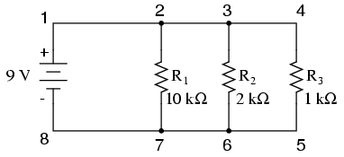
Parallel Circuit Example

Slide 8
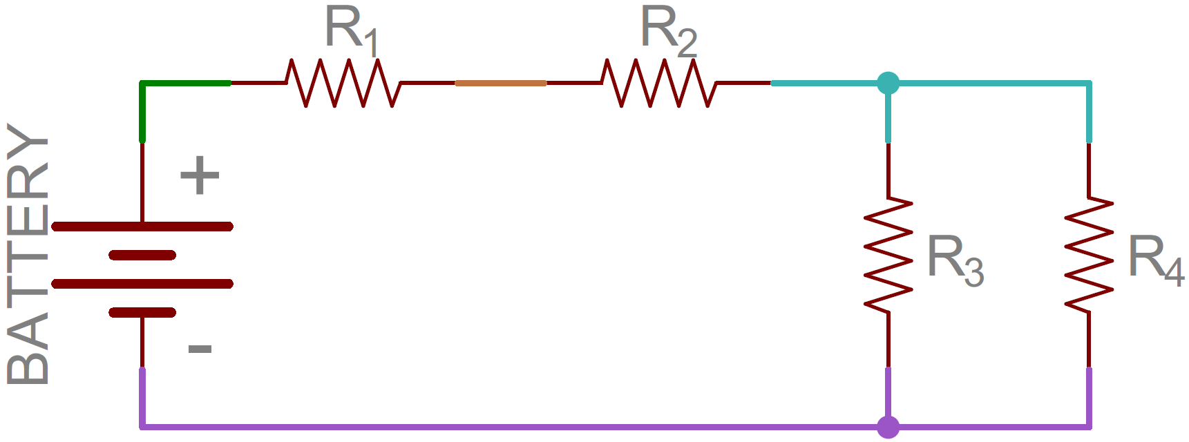
Parallel Circuit Example

Slide 9
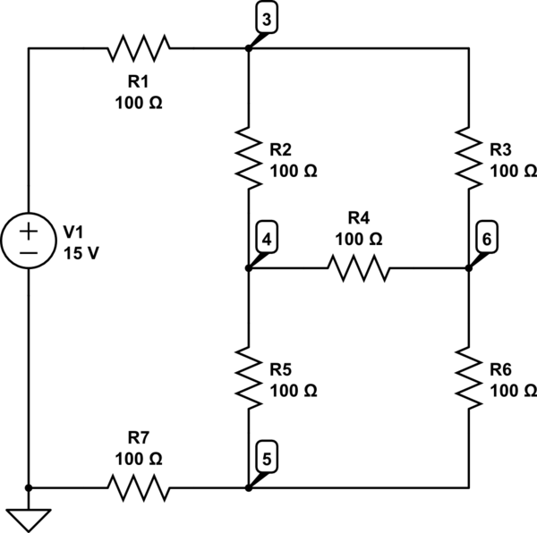
Parallel Circuit Example

Slide 10
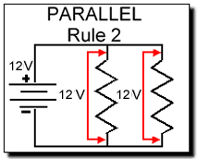
Parallel Circuit Voltage and Current
Because the loads are connected across the line the energy source provides the same voltage to the loads
In series there was voltage drop between the loads
The total current however is distributed among the branches
The amount of current can be found by using Ohm’s Law ( I = V/R )
The lower the resistance is in any branch the greater the current
Lights and small appliances that operates at the same voltage require different amounts of current and is why they would be connected in parallel

Slide 11
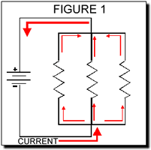
Parallel Resistance Formulas
1/R_{t} = 1/R₁ + 1/R₂ + 1/R₃ + …
REMEMBER* The total resistance of a parallel circuit is NOT equal to the sum of the resistors

Slide 12
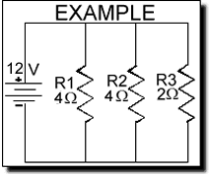
Parallel Resistance Formulas
Let's summarize this EXAMPLE:
Voltage = 12V
R1 = 4 Ohm
R2 = 4 Ohm
R3 = 2 Ohm

Slide 13
Parallel Resistance Formulas
1 — = Rt | 1 — + R1 | 1 — + R2 | 1 — R3

Slide 14
Parallel Resistance Formulas
1 — = Rt | 1 — + 4 | 1 — + 4 | 1 — 2

Slide 15
Parallel Resistance Formulas
It is easiest to change the fractions into decimal numbers (example 1 divide by 4 equals .25):
1/R_{t} = .25 + .25 + .5
1/R_{t} = 1

Slide 16
Parallel Resistance Formulas
Now you have to get rid of the 1 on the left side so...
R_{t} = 1/1
R_{t} = 1 Ohms

